Slide 1


Joint Action
conceptual tools for scientific research

Slide 2
Joint action:
a goal-directed action, or something resembling one, comprising two or more agents’ goal-directed activities.

Slide 3
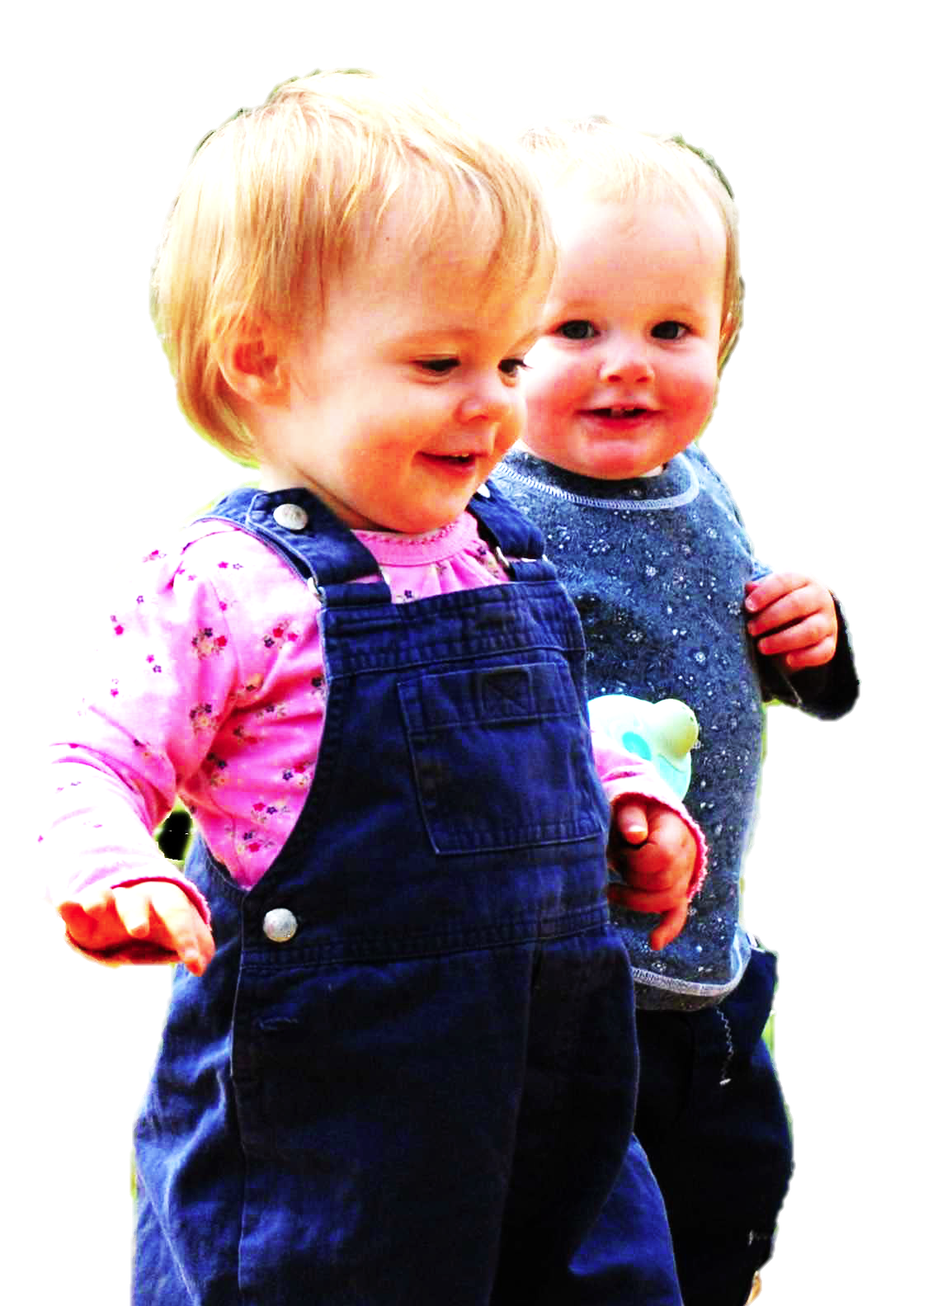
Joint action:
a goal-directed action, or something resembling one, comprising two or more agents’ goal-directed activities.
tidying up the toys together
(Behne et al 2005)
cooperatively pulling handles in sequence to make a dog-puppet sing
(Brownell et al 2006)
bouncing a ball on a large trampoline together
(Tomasello & Carpenter 2007)
pretending to row a boat together

Slide 4


Joint action:
a goal-directed action, or something resembling one, comprising two or more agents’ goal-directed activities.
“perception, action, and cognition are grounded in social interaction”
(Sebanz & Knoblich 2008)

Slide 5


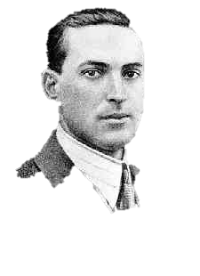
Joint action:
a goal-directed action, or something resembling one, comprising two or more agents’ goal-directed activities.
“regular participation in cooperative, cultural interactions during ontogeny leads children to construct uniquely powerful forms of cognitive representation.”
(Moll & Tomasello 2007)
“perception, action, and cognition are grounded in social interaction”
(Sebanz & Knoblich 2008)

Slide 6


Slide 7

first
part

Slide 8
‘I take a collective action to involve a collective [shared] intention.’
(Gilbert 2006, p. 5)
‘The sine qua non of collaborative action is a joint goal [shared intention] and a joint commitment’
(Tomasello 2008, p. 181)
‘the key property of joint action lies in its internal component [...] in the participants’ having a “collective” or “shared” intention.’
(Alonso 2009, pp. 444-5)
‘Shared intentionality is the foundation upon which joint action is built.’
(Carpenter 2009, p. 381)

Slide 9
‘I take a collective action to involve a collective [shared] intention.’
(Gilbert 2006, p. 5)
‘The sine qua non of collaborative action is a joint goal [shared intention] and a joint commitment’
(Tomasello 2008, p. 181)
‘the key property of joint action lies in its internal component [...] in the participants’ having a “collective” or “shared” intention.’
(Alonso 2009, pp. 444-5)
‘Shared intentionality is the foundation upon which joint action is built.’
(Carpenter 2009, p. 381)
Notes:
shared intention is hard to characterise ... different philosophers have taken different approaches ... will focus on Bratman as this is a good starting point

Slide 10
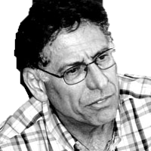

Slide 11
What is shared intention?
Functional characterisation
Substantial account

Slide 12
What is shared intention?
Functional characterisation
shared intention serves to (a) coordinate activities, (b) coordinate planning and (c) structure bargaining
Substantial account

Slide 13
What is shared intention?
Functional characterisation
shared intention serves to (a) coordinate activities, (b) coordinate planning and (c) structure bargaining
Substantial account
We have a shared intention that we J =
“1. (a) I intend that we J and (b) you intend that we J
“2. I intend that we J in accordance with and because of la, lb, and meshing subplans of la and lb; you intend [likewise] …
“3. 1 and 2 are common knowledge between us”
(Bratman 1993: View 4)

Slide 14
What is shared intention?
Functional characterisation
shared intention serves to (a) coordinate activities, (b) coordinate planning and (c) structure bargaining
Substantial account
We have a shared intention that we J =
“1. (a) I intend that we J and (b) you intend that we J
“2. I intend that we J in accordance with and because of la, lb, and meshing subplans of la and lb; you intend [likewise] …
“3. 1 and 2 are common knowledge between us”
(Bratman 1993: View 4)
{
Intentions about intentions

Slide 15
What is shared intention?
Functional characterisation
shared intention serves to (a) coordinate activities, (b) coordinate planning and (c) structure bargaining
Substantial account
We have a shared intention that we J =
“1. (a) I intend that we J and (b) you intend that we J
“2. I intend that we J in accordance with and because of la, lb, and meshing subplans of la and lb; you intend [likewise] …
“3. 1 and 2 are common knowledge between us”
(Bratman 1993: View 4)
{
Intentions about intentions
{
Knowledge of others’ knowledge of intentions about intentions

Slide 16
“philosophers ... postulate complex intentional structures that often seem to be beyond human cognitive ability in real-time social interactions.”
(Knoblich & Sebanz 2008: 2022)
What is shared intention?
Functional characterisation
shared intention serves to (a) coordinate activities, (b) coordinate planning and (c) structure bargaining
Substantial account
We have a shared intention that we J =
“1. (a) I intend that we J and (b) you intend that we J
“2. I intend that we J in accordance with and because of la, lb, and meshing subplans of la and lb; you intend [likewise] …
“3. 1 and 2 are common knowledge between us”
(Bratman 1993: View 4)
{
Intentions about intentions
{
Knowledge of others’ knowledge of intentions about intentions

Slide 17
“philosophers ... postulate complex intentional structures that often seem to be beyond human cognitive ability in real-time social interactions.”
Functional characterisation
shared intention serves to (a) coordinate activities, (b) coordinate planning and (c) structure bargaining
Substantial account
We have a shared intention that we J =
“1. (a) I intend that we J and (b) you intend that we J
“2. I intend that we J in accordance with and because of la, lb, and meshing subplans of la and lb; you intend [likewise] …
“3. 1 and 2 are common knowledge between us”
(Bratman 1993: View 4)
{
Intentions about intentions
{
Knowledge of others’ knowledge of intentions about intentions

Slide 18
travel
buy
Jon
Notes:
want to surprise Jon, so plan to travel to the shops and buy him a book and then give it to him.

Slide 19
travel
buy
Jon
travel
buy
Al
Notes:
same thing for Al --- want to surprise him and so plan to go to the shops, buy him some grappa and give it to him. Either plan is fine by itself. but they can’t both be executed by me because I don’t have enough money for both.

Slide 20
travel
buy
Jon
travel
buy
Al
Notes:
same thing for Al --- want to surprise him and so plan to go to the shops, buy him some grappa and give it to him. Either plan is fine by itself. but they can’t both be executed by me because I don’t have enough money for both.

Slide 21
“philosophers ... postulate complex intentional structures that often seem to be beyond human cognitive ability in real-time social interactions.”
Functional characterisation
shared intention serves to (a) coordinate activities, (b) coordinate planning and (c) structure bargaining
Substantial account
We have a shared intention that we J =
“1. (a) I intend that we J and (b) you intend that we J
“2. I intend that we J in accordance with and because of la, lb, and meshing subplans of la and lb; you intend [likewise] …
“3. 1 and 2 are common knowledge between us”
(Bratman 1993: View 4)
{
Intentions about intentions
{
Knowledge of others’ knowledge of intentions about intentions

Slide 22
“philosophers ... postulate complex intentional structures that often seem to be beyond human cognitive ability in real-time social interactions.”
“philosophers ... postulate complex intentional structures that often seem to be beyond human cognitive ability in real-time social interactions.”
(Knoblich & Sebanz 2008: 2022)
Functional characterisation
shared intention serves to (a) coordinate activities, (b) coordinate planning and (c) structure bargaining
Substantial account
We have a shared intention that we J =
“1. (a) I intend that we J and (b) you intend that we J
“2. I intend that we J in accordance with and because of la, lb, and meshing subplans of la and lb; you intend [likewise] …
“3. 1 and 2 are common knowledge between us”
(Bratman 1993: View 4)
{
Intentions about intentions
{
Knowledge of others’ knowledge of intentions about intentions

Slide 23
1. All (significant) joint actions require shared intention.
2. Shared intention requires conceptual sophistication and is typically cognitively demanding.

Slide 24
1. All (significant) joint actions require shared intention.
2. Shared intention requires sophisticated mindreading abilities.

Slide 25
1. All (significant) joint actions require shared intention.
2. Shared intention requires sophisticated mindreading abilities.

Slide 26
change nappy
Notes:
Typically an action involves many different components other than intention. Let me just lay out a crude picture of an intentional action to fix terminology. [...] Given this picture It’s clearly a prejudice to think that joint action depends on meshing of intentions rather than meshing at other levels. My suggestion, then, is that if we want to understand potential roles of joint action in evolution or in development, we should focus on meshing not of intentions but of motor actions and goals.

Slide 27
change nappy
plans
prepare infant
prepare nappy
assemble

Slide 28
change nappy
plans
prepare infant
prepare nappy
assemble
goals
strip clothes
clean bum
open
place under
close studs

Slide 29
change nappy
plans
prepare infant
prepare nappy
assemble
goals
strip clothes
clean bum
open
place under
close studs
… /reach X/ /grasp X/ /grasp Y/ /pull Y/ /scoop X/ /Y out of X/ …
motor action

Slide 30
change nappy
plans
prepare infant
prepare nappy
assemble
goals
strip clothes
clean bum
open
place under
close studs
… /reach X/ /grasp X/ /grasp Y/ /pull Y/ /scoop X/ /Y out of X/ …
motor action
… [reach-left-hand X] [left-wholehand-grasp X] [right-wholehand-grasp …

Slide 31


change nappy
plans
prepare infant
prepare nappy
assemble
goals
strip clothes
clean bum
open
place under
close studs
… /reach X/ /grasp X/ /grasp Y/ /pull Y/ /scoop X/ /Y out of X/ …
motor action
… [reach-left-hand X] [left-wholehand-grasp X] [right-wholehand-grasp …
motion
Image adapted from: Rizzolatti, Giacomo, and Giuseppe Luppino. 2001. The Cortical Motor System. Neuron 31, no. 6 (September 27): 889-901. doi:10.1016/S0896-6273(01)00423-8.

Slide 32
case
studies

Slide 33
awareness of joint-ness
at least one of the agents knows that they are not acting individually; she or they have ‘a conception of themselves as contributors to a collective end.’
awareness of others’ agency
at least one of the agents is aware of one or more of the others as an intentional agent.
awareness of others’ states or commitments
at least one of the agents who are F-ing is aware of, or has individuating beliefs about, some of the others’ intentions, beliefs or commitments concerning F.

Slide 34
awareness of joint-ness
at least one of the agents knows that they are not acting individually; she or they have ‘a conception of themselves as contributors to a collective end.’
awareness of others’ agency
at least one of the agents is aware of one or more of the others as an intentional agent.
awareness of others’ states or commitments
at least one of the agents who are F-ing is aware of, or has individuating beliefs about, some of the others’ intentions, beliefs or commitments concerning F.

Slide 35
awareness of joint-ness
at least one of the agents knows that they are not acting individually; she or they have ‘a conception of themselves as contributors to a collective end.’
awareness of others’ agency
at least one of the agents is aware of one or more of the others as an intentional agent.
awareness of others’ states or commitments
at least one of the agents who are F-ing is aware of, or has individuating beliefs about, some of the others’ intentions, beliefs or commitments concerning F.

Slide 36
awareness of joint-ness
at least one of the agents knows that they are not acting individually; she or they have ‘a conception of themselves as contributors to a collective end.’
awareness of others’ agency
at least one of the agents is aware of one or more of the others as an intentional agent.
awareness of others’ states or commitments
at least one of the agents who are F-ing is aware of, or has individuating beliefs about, some of the others’ intentions, beliefs or commitments concerning F.

Slide 37
awareness of joint-ness
at least one of the agents knows that they are not acting individually; she or they have ‘a conception of themselves as contributors to a collective end.’
awareness of others’ agency
at least one of the agents is aware of one or more of the others as an intentional agent.
awareness of others’ states or commitments
at least one of the agents who are F-ing is aware of, or has individuating beliefs about, some of the others’ intentions, beliefs or commitments concerning F.
Joint action:
a goal-directed action, or something resembling one, comprising two or more agents’ goal-directed activities.

Slide 38
awareness of joint-ness
at least one of the agents knows that they are not acting individually; she or they have ‘a conception of themselves as contributors to a collective end.’
awareness of others’ agency
at least one of the agents is aware of one or more of the others as an intentional agent.
awareness of others’ states or commitments
at least one of the agents who are F-ing is aware of, or has individuating beliefs about, some of the others’ intentions, beliefs or commitments concerning F.
Joint action:
a goal-directed action, or something resembling one, comprising two or more agents’ goal-directed activities.

Slide 39
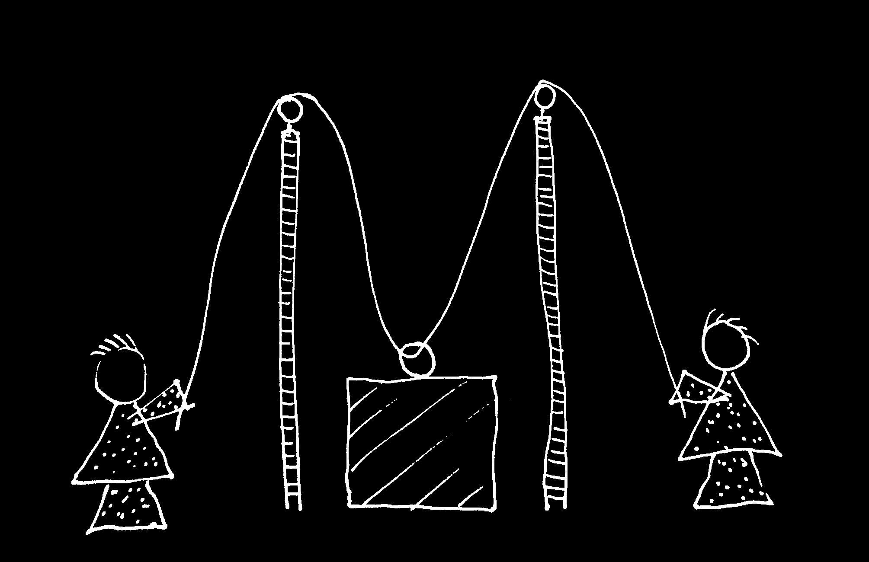
cf. Vesper et al (Neural Networks 2010)

Slide 40


Slide 41
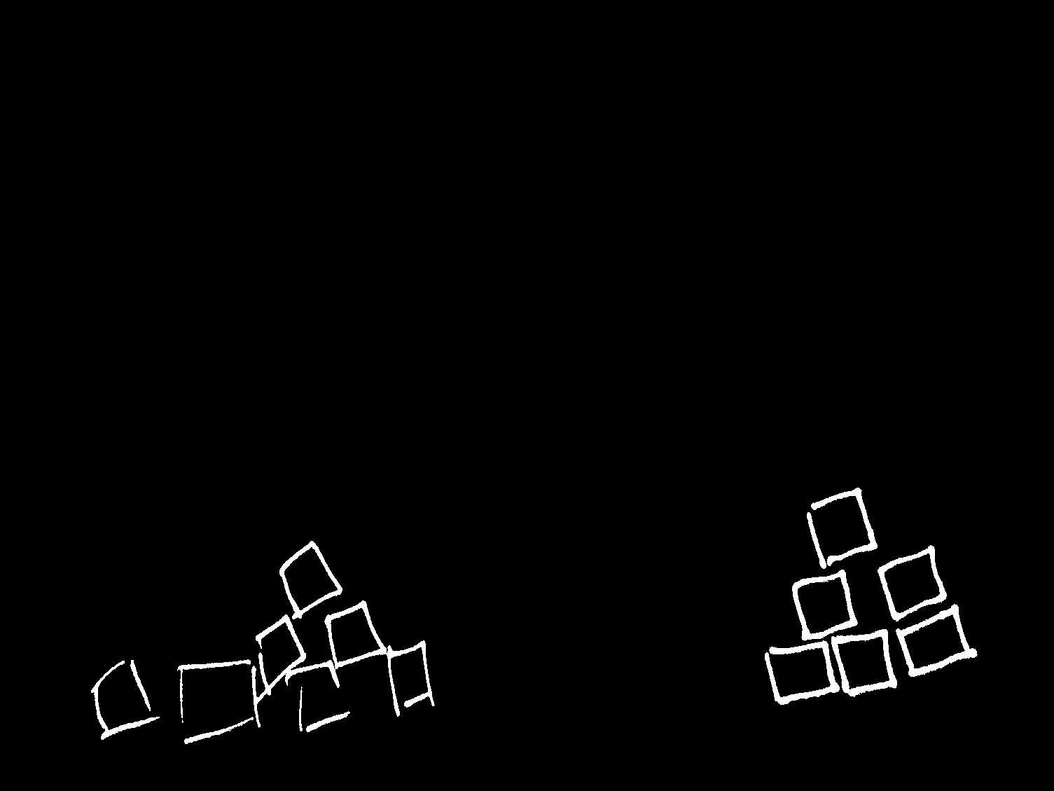

Slide 43
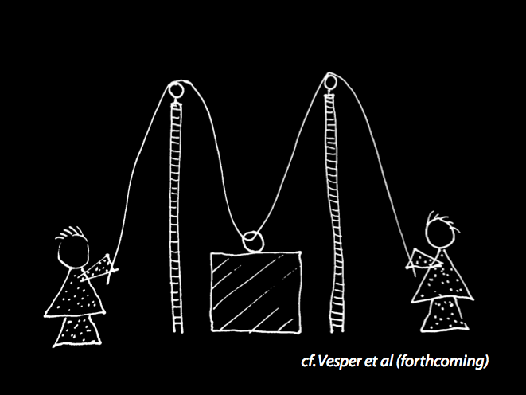
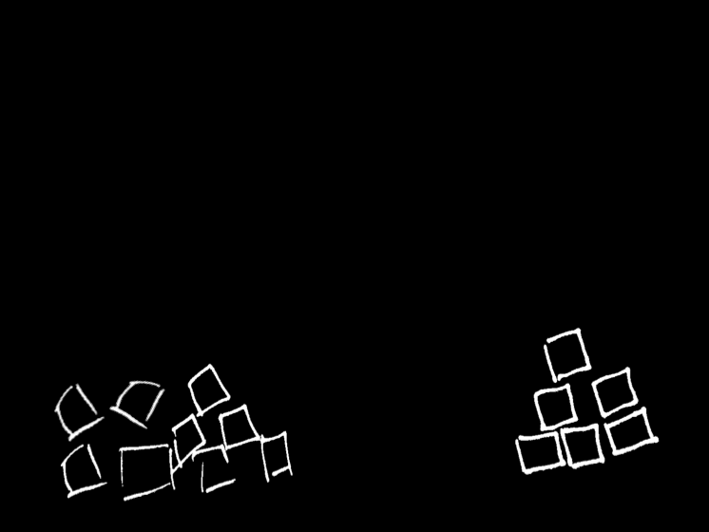

Slide 44
second
part

Slide 45
What is the relation between a joint action and the goal (or goals) to which it is directed?

Slide 46

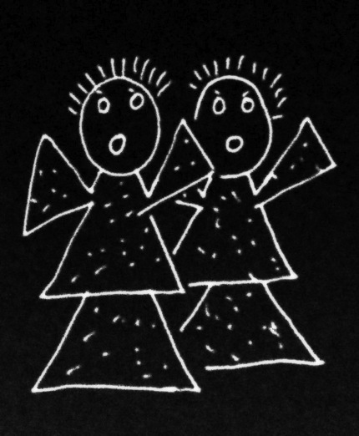
What is the relation between a joint action and the goal (or goals) to which it is directed?

Slide 47
What is the relation between a joint action and the goal (or goals) to which it is directed?

Slide 48
Joint action: a goal-directed action, or something resembling one, comprising two or more agents’ goal-directed activities.
amuse
act
smash
free
act
alarm

Slide 49
Joint action: a goal-directed action, or something resembling one, comprising two or more agents’ goal-directed activities.
amuse
act
smash
free
act
alarm

Slide 50
Joint action: a goal-directed action, or something resembling one, comprising two or more agents’ goal-directed activities.
amuse
act
smash
free
act
shared intention
alarm

Slide 51
Joint action: a goal-directed action, or something resembling one, comprising two or more agents’ goal-directed activities.
amuse
act
smash
free
act
shared intention
OR
???
alarm

Slide 52
Joint action: a goal-directed action, or something resembling one, comprising two or more agents’ goal-directed activities.
G is a distributive goal: it is an outcome to which each agent’s activities are individually directed and it is possible that: all agents succeed relative to this outcome.

Slide 53
Joint action: a goal-directed action, or something resembling one, comprising two or more agents’ goal-directed activities.
G is a distributive goal: it is an outcome to which each agent’s activities are individually directed and it is possible that: all agents succeed relative to this outcome.
G is a collective goal
(a) it is a distributive goal;
(b) the agents’ activities are coordinated; and
(c) this type of outcome would normally be facilitated by this type of coordination.

Slide 54
Joint action: a goal-directed action, or something resembling one, comprising two or more agents’ goal-directed activities.
G is a distributive goal: it is an outcome to which each agent’s activities are individually directed and it is possible that: all agents succeed relative to this outcome.
G is a collective goal
(a) it is a distributive goal;
(b) the agents’ activities are coordinated; and
(c) this type of outcome would normally be facilitated by this type of coordination.

Slide 55
Joint action: a goal-directed action, or something resembling one, comprising two or more agents’ goal-directed activities.
G is a distributive goal: it is an outcome to which each agent’s activities are individually directed and it is possible that: all agents succeed relative to this outcome.
G is a shared goal
G is a collective goal
(a) it is a distributive goal;
(b) the agents’ activities are coordinated; and
(c) this type of outcome would normally be facilitated by this type of coordination.
Each agent expects each of the other agents to perform activities directed to the goal.
Each agent expects the goal to occur as a common effect of all their goal-directed actions.

Slide 56
Substantial account
We have a shared intention that we J =
“1. (a) I intend that we J and (b) you intend that we J
“2. I intend that we J in accordance with and because of la, lb, and meshing subplans of la and lb; you intend [likewise] …
“3. 1 and 2 are common knowledge between us”
(Bratman 1993: View 4)

Slide 57
Substantial account
We have a shared intention that we J =
“1. (a) I intend that we J and (b) you intend that we J
“2. I intend that we J in accordance with and because of la, lb, and meshing subplans of la and lb; you intend [likewise] …
“3. 1 and 2 are common knowledge between us”
(Bratman 1993: View 4)
{
Intentions about intentions
{
Knowledge of others’ knowledge of intentions about intentions

Slide 58
“philosophers ... postulate complex intentional structures that often seem to be beyond human cognitive ability in real-time social interactions.”
(Knoblich & Sebanz 2008: 2022)
What is shared intention?
Functional characterisation
shared intention serves to (a) coordinate activities, (b) coordinate planning and (c) structure bargaining
Substantial account
We have a shared intention that we J =
“1. (a) I intend that we J and (b) you intend that we J
“2. I intend that we J in accordance with and because of la, lb, and meshing subplans of la and lb; you intend [likewise] …
“3. 1 and 2 are common knowledge between us”
(Bratman 1993: View 4)
{
Intentions about intentions
{
Knowledge of others’ knowledge of intentions about intentions

Slide 59
“philosophers ... postulate complex intentional structures that often seem to be beyond human cognitive ability in real-time social interactions.”
Functional characterisation
shared intention serves to (a) coordinate activities, (b) coordinate planning and (c) structure bargaining
Substantial account
We have a shared intention that we J =
“1. (a) I intend that we J and (b) you intend that we J
“2. I intend that we J in accordance with and because of la, lb, and meshing subplans of la and lb; you intend [likewise] …
“3. 1 and 2 are common knowledge between us”
(Bratman 1993: View 4)
{
Intentions about intentions
{
Knowledge of others’ knowledge of intentions about intentions

Slide 60


Slide 61

‘Ayesha and Beatrice between them lifted the table’

Slide 62
‘Ayesha and Beatrice between them lifted the table’
‘Left Leg and Right Leg between them supported the table’
‘Ayesha and Beatrice between them lifted the table intentionally’

Slide 63
‘Ayesha and Beatrice between them lifted the table’
‘Left Leg and Right Leg between them supported the table’
‘Ayesha and Beatrice between them lifted the table intentionally’

